Slide 1
Introduction to IOT
G.Mallikarjuna Rao

Slide 2
Syllabus
Unit III
Introduction To Internet of Things: Introduction, Physical Design of IoT, Logical Design of IoT, IoT enabling Technologies, IoT Levels and Deployment Templates
Domain Specific IoTs: Introduction, Home Automation, Smart Cities, Environment, Energy, Retail, Logistics, Agriculture, Industry, Health and LifeStyle
UNIT IV
IoT Systems- Logical Design Using Python: Introduction, Installing python, Python data types and data structures, Control Flow, Functions, Modules, Packages, File Handling, Date/ Time operations, Classes, Python Packages of Interest for IoT.
IoT Physical Devices And End Points: IoT Device, Exemplary Device: Raspberry Pi, About the board, Linux on Raspberry Pi, Raspberry Pi Interfaces, Programming Raspberry Pi with Python

Slide 3
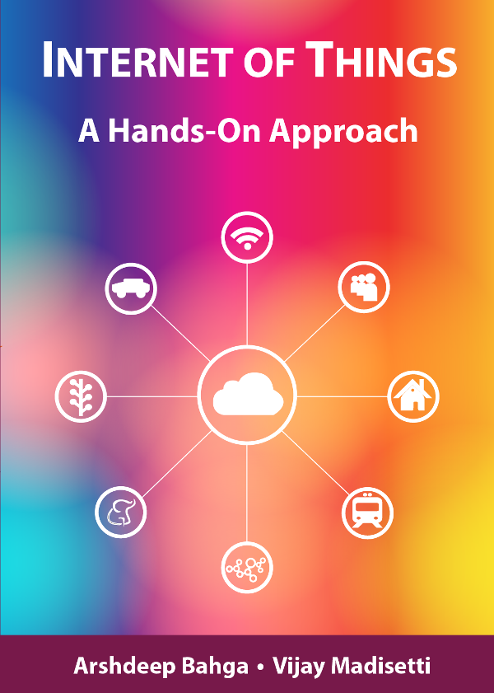
Chapter 1
Introduction to IoT
Book website: http://www.internet-of-things-book.com
Bahga & Madisetti, © 2015

Slide 4
Logical Design
Logical design of IoT system refers to an abstract representation of the entities & processes without going into the low-level specifies of the implementation. For understanding Logical Design of IoT, we describes given below terms.
IoT Functional Blocks
IoT Communication Models
IoT Communication APIs

Slide 5
IOT Functional Blocks
IOT functional blocks that provide the system the capabilities for identification, sensing, actuation, communication and management. functional blocks are:
Device: An IoT system comprises of devices that provide sensing, actuation, monitoring and control functions.
Communication: Handles the communication for the IoT system.
Services: services for device monitoring, device control service, data publishing services and services for device discovery.
Management: this blocks provides various functions to govern the IoT system.
Security: this block secures the IoT system and by providing functions such as authentication , authorization, message and content integrity, and data security.
Application: This is an interface that the users can use to control and monitor various aspects of the IoT system. Application also allow users to view the system status and view or analyze the processed data.

Slide 6
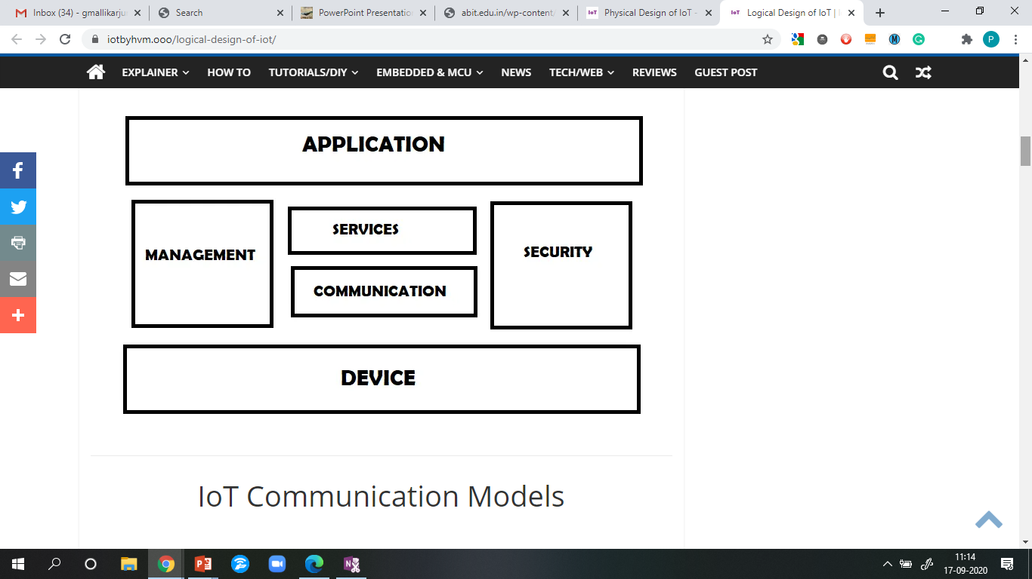
IOT Functional blocks

Slide 7
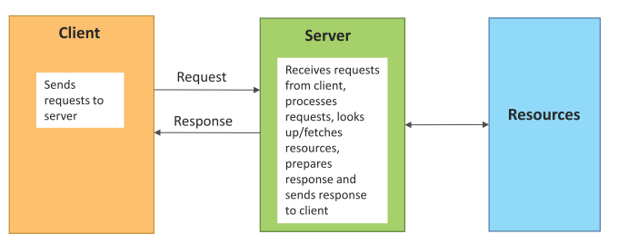
Communication Models: Request-Response communication model
Request-Response is a communication model in which the client sends requests to the server and the server responds to the requests.
When the server receives a request, it decides how to respond, fetches the data, retrieves resource representations, prepares the response, and then sends the response to the client.
Representations:
JavaScript Object Notation (JSON)
XML
Book website: http://www.internet-of-things-book.com
Bahga & Madisetti, © 2015

Slide 8
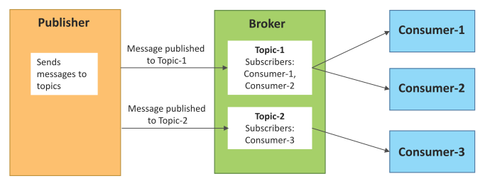
Publish-Subscribe communication model
Publish-Subscribe is a communication model that involves publishers, brokers and consumers.
Publishers are the source of data. Publishers send the data to the topics which are managed by the broker. Publishers are not aware of the consumers.
Consumers subscribe to the topics which are managed by the broker.
When the broker receives data for a topic from the publisher, it sends the data to all the subscribed consumers.
Book website: http://www.internet-of-things-book.com
Bahga & Madisetti, © 2015

Slide 9
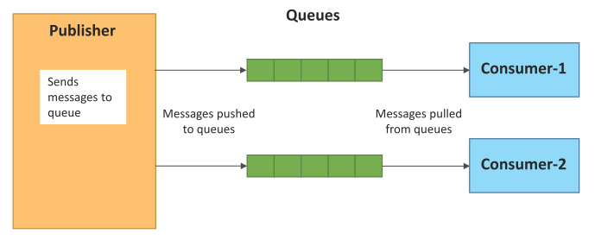
Push-Pull communication model
Push-Pull is a communication model in which the data producers push the data to queues and the consumers pull the data from the queues. Producers do not need to be aware of the consumers.
Queues help in decoupling the messaging between the producers and consumers.
Queues also act as a buffer which helps in situations when there is a mismatch between the rate at which the producers push data and the rate at which the consumers pull data.
Book website: http://www.internet-of-things-book.com
Bahga & Madisetti, © 2015

Slide 10
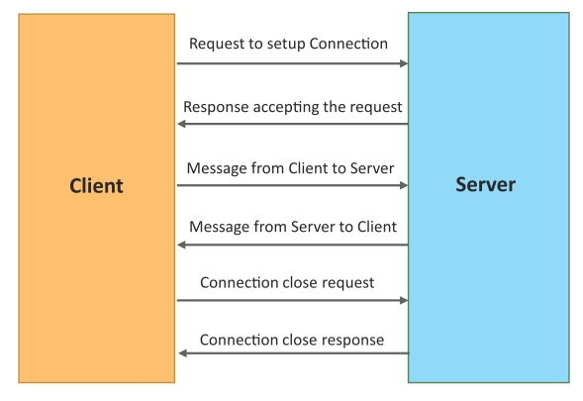
Exclusive Pair communication model
Exclusive Pair is a bidirectional, fully duplex communication model that uses a persistent connection between the client and server.
Once the connection is setup it remains open until the client sends a request to close the connection.
Client and server can send messages to each other after connection setup.
Book website: http://www.internet-of-things-book.com
Bahga & Madisetti, © 2015

Slide 11
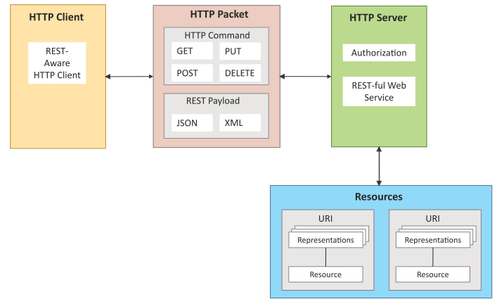
REST-based Communication APIs
Representational State Transfer (REST) is a set of architectural principles by which you can design web services and web APIs that focus on a system’s resources and how resource states are addressed and transferred.
REST APIs follow the request-response communication model.
The REST architectural constraints apply to the components, connectors, and data elements, within a distributed hypermedia system.
Book website: http://www.internet-of-things-book.com
Bahga & Madisetti, © 2015

Slide 12
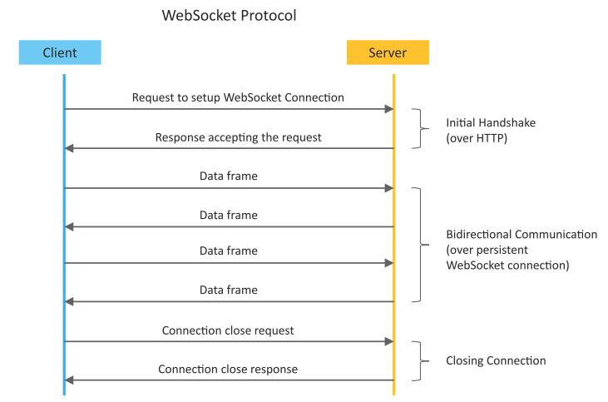
WebSocket-based Communication APIs
WebSocket APIs allow bi-directional, full duplex communication between clients and servers.
WebSocket APIs follow the exclusive pair communication model
Book website: http://www.internet-of-things-book.com
Bahga & Madisetti, © 2015

Slide 13
IOT Communication APIs
Generally we used Two APIs For IoT Communication. These IoT Communication APIs are:
REST-based Communication APIs
WebSocket-based Communication APIs
REST-based Communication APIs :Representational state transfer (REST) is a set of architectural principles by which you can design Web services the Web APIs that focus on systems’s resources and how resource states are addressed and transferred. REST APIs that follow the request response communication model. The rest architectural constraint are as follows:
Client-server – The principle behind the client-server constraint is the separation of concerns. Ex: clients should not be concerned with the storage of data which is concern of the server and the server should not be concerned about the user interface, which is concern of the client. Separation allows client and server to be independently developed and updated.

Slide 14
IOT Communication APIs
Stateless – Each request from client to server must contain all the information necessary to understand the request, and cannot take advantage of any stored context on the server. The session state is kept entirely on the client.
Cache-able – Cache constraints requires that the data within a response to a request be implicitly or explicitly leveled as cache-able or non cache-able. If a response is cache-able, then a client cache is given the right to reuse that response data for later, equivalent requests. Caching can partially or completely eliminate some instructions and improve efficiency and scalability.
Layered system – layered system constraints, constrains the behavior of components such that each component cannot see beyond the immediate layer with they are interacting. For example, the client cannot tell whether it is connected directly to the end server or two an intermediary along the way. System scalability can be improved by allowing intermediaries to respond to requests instead of the end server, without the client having to do anything different.

Slide 15
IOT Communication APIs
Uniform interface – uniform interface constraints requires that the method of communication between client and server must be uniform. Resources are identified in the requests (by URL’s in web based systems) and are themselves is separate from the representations of the resources data returned to the client. When a client holds a representation of resources it has all the information required to update or delete the resource (provided the client has required permissions). Each message includes enough information to describe how to process the message.
Code on demand – Servers can provide executable code or scripts for clients to execute in their context. this constraint is the only one that is optional.
A RESTful web service is a ” Web API ” implemented using HTTP and REST principles. REST is most popular IoT Communication APIs.

Slide 16
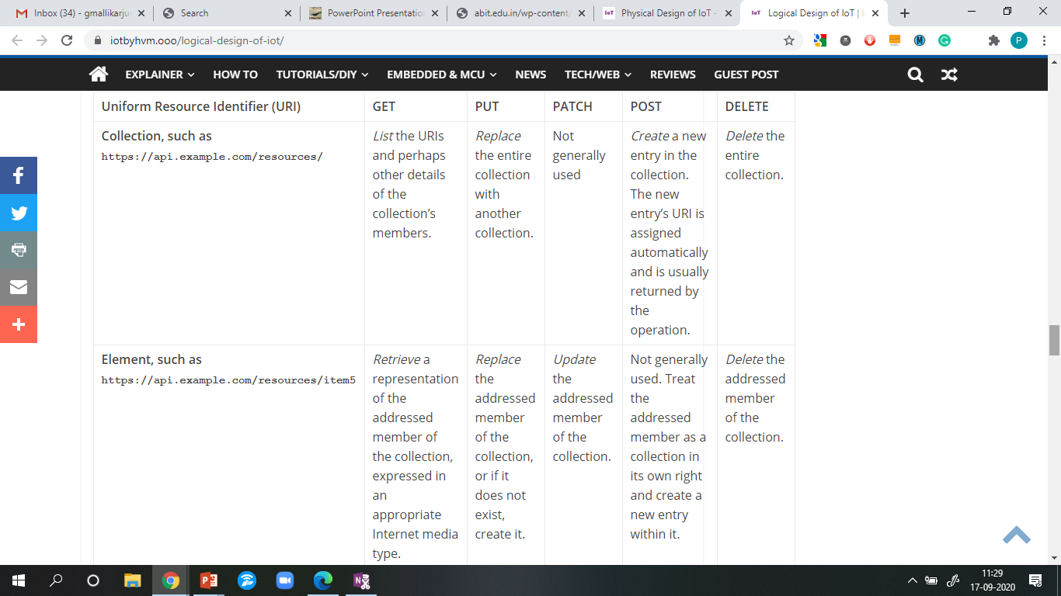

Slide 17
IoT Levels & Deployment Templates
An IoT system comprises of the following components:
Device: An IoT device allows identiﬁcation, remote sensing, actuating and remote monitoring capabilities.
Resource: Resources are software components on the IoT device for accessing, processing, and storing sensor information, or controlling actuators connected to the device. Resources also include the software components that enable network access for the device.
Controller Service: Controller service is a native service that runs on the device and interacts with the web services. Controller service sends data from the device to the web service and receives commands from the application (via web services) for controlling the device.
Book website: http://www.internet-of-things-book.com
Bahga & Madisetti, © 2015

Slide 18
IoT Levels & Deployment Templates
Database: Database can be either local or in the cloud and stores the data generated by the IoT device.
Web Service: Web services serve as a link between the IoT device, application, database and analysis components. Web service can be either implemented using HTTP and REST principles (REST service) or using WebSocket protocol (WebSocket service).
Analysis Component: The Analysis Component is responsible for analyzing the IoT data and generate results in a form which are easy for the user to understand.
Application: IoT applications provide an interface that the users can use to control and monitor various aspects of the IoT system. Applications also allow users to view the system status and view the processed data.
Book website: http://www.internet-of-things-book.com
Bahga & Madisetti, © 2015

Slide 19
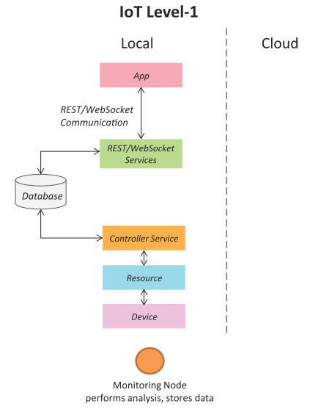
IoT Level-1
A level-1 IoT system has a single node/device that performs sensing and/or actuation, stores data, performs analysis and hosts the application
Level-1 IoT systems are suitable for modeling low-cost and low-complexity solutions where the data involved is not big and the analysis requirements are not computationally intensive.
Book website: http://www.internet-of-things-book.com
Bahga & Madisetti, © 2015

Slide 20
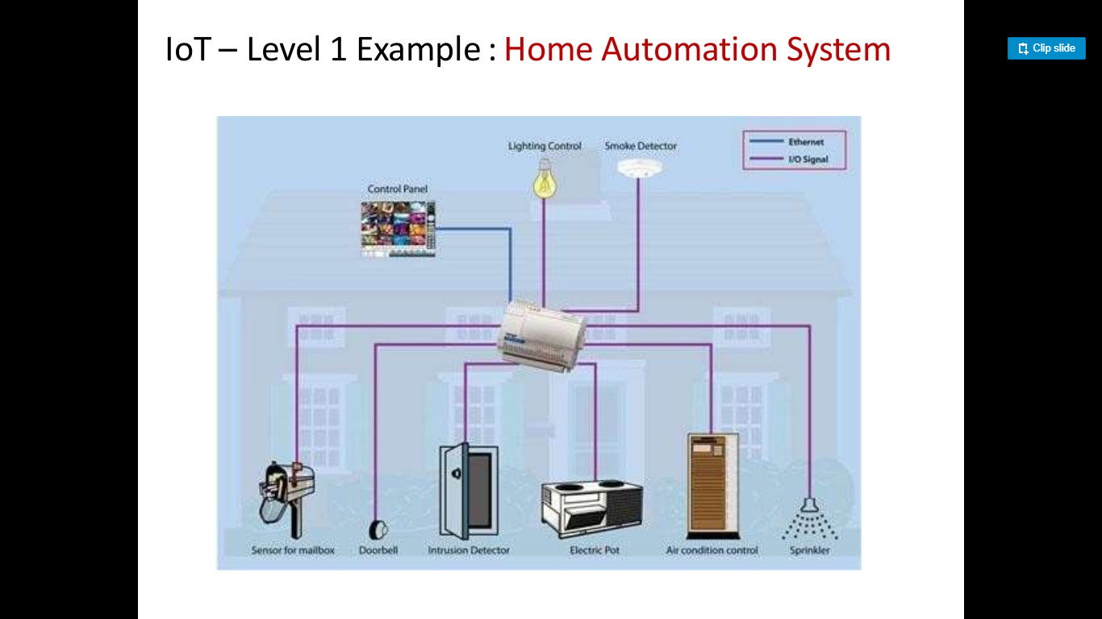

Slide 21
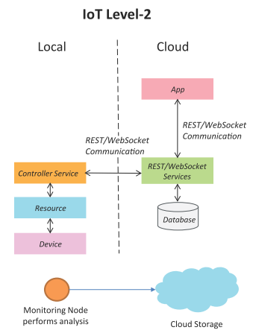
IoT Level-2
A level-2 IoT system has a single node that performs sensing and/or actuation and local analysis.
Data is stored in the cloud and application is usually cloud-based.
Level-2 IoT systems are suitable for solutions where the data involved is big, however, the primary analysis requirement is not computationally intensive and can be done locally itself.
Book website: http://www.internet-of-things-book.com
Bahga & Madisetti, © 2015

Slide 22
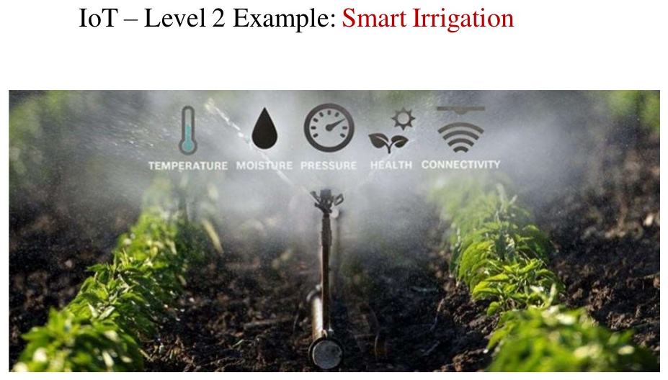

Slide 23
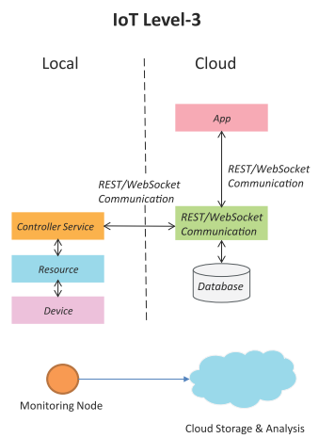
IoT Level-3
A level-3 IoT system has a single node. Data is stored and analyzed in the cloud and application is cloud-based.
Level-3 IoT systems are suitable for solutions where the data involved is big and the analysis requirements are computationally intensive.
Book website: http://www.internet-of-things-book.com
Bahga & Madisetti, © 2015

Slide 24
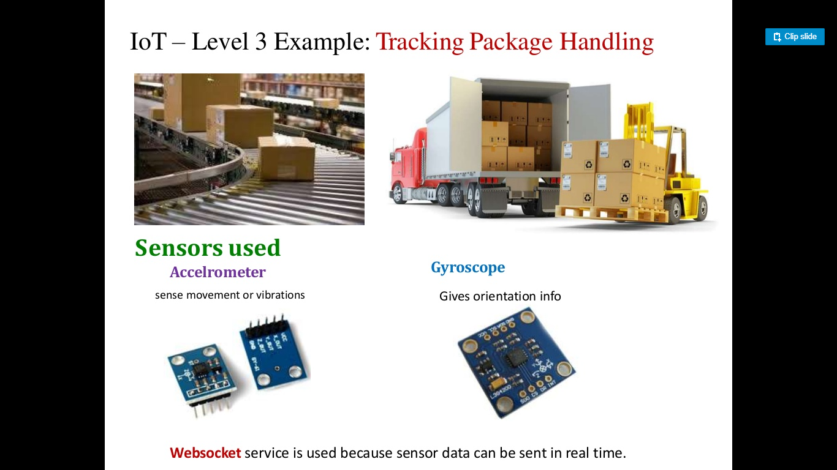

Slide 25
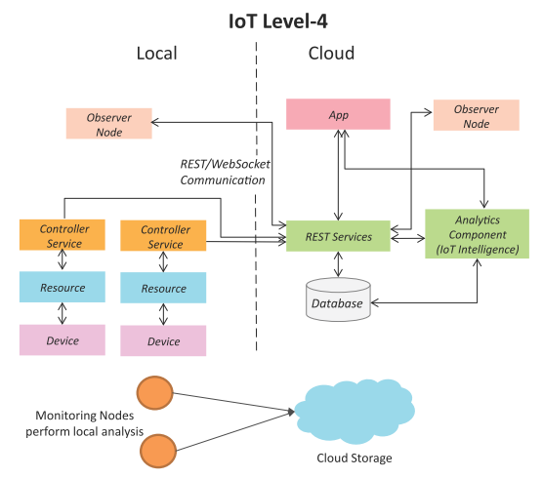
IoT Level-4
A level-4 IoT system has multiple nodes that perform local analysis. Data is stored in the cloud and application is cloud-based.
Level-4 contains local and cloud-based observer nodes which can subscribe to and receive information collected in the cloud from IoT devices.
Level-4 IoT systems are suitable for solutions where multiple nodes are required, the data involved is big and the analysis requirements are computationally intensive.
Book website: http://www.internet-of-things-book.com
Bahga & Madisetti, © 2015

Slide 26
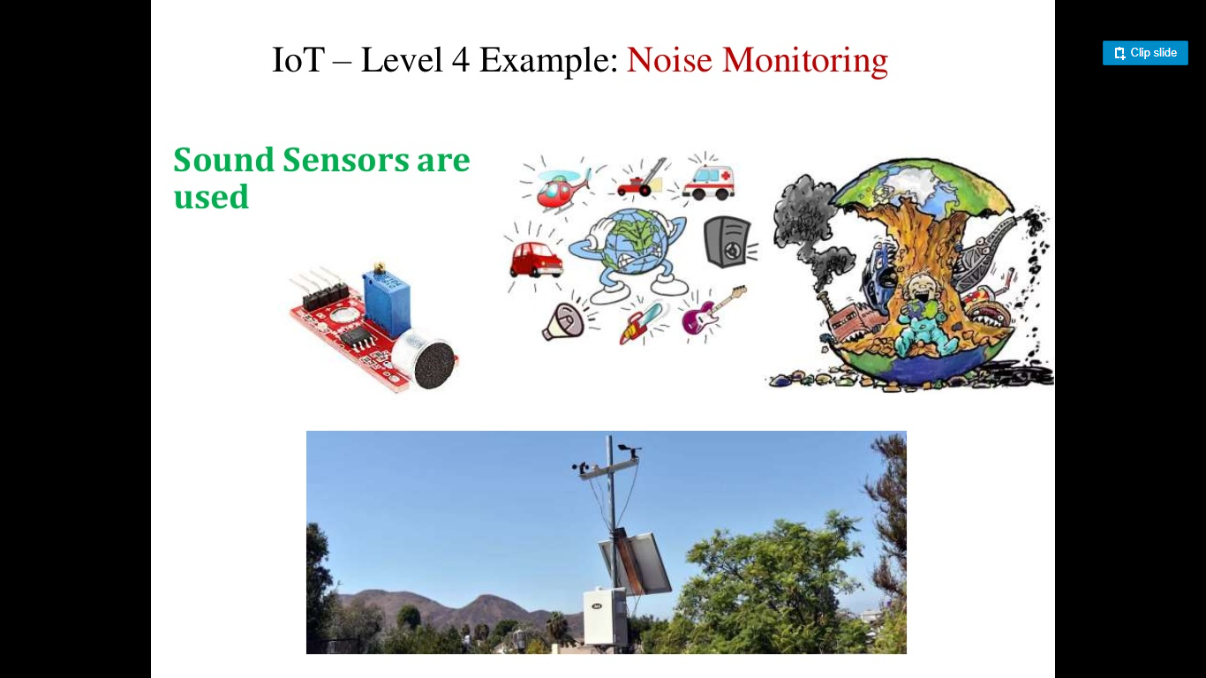

Slide 27
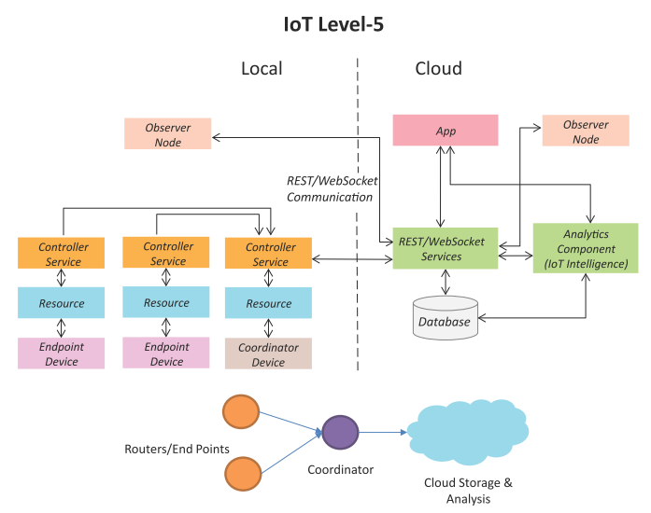
IoT Level-5
A level-5 IoT system has multiple end nodes and one coordinator node.
The end nodes that perform sensing and/or actuation.
Coordinator node collects data from the end nodes and sends to the cloud.
Data is stored and analyzed in the cloud and application is cloud-based.
Level-5 IoT systems are suitable for solutions based on wireless sensor networks, in which the data involved is big and the analysis requirements are computationally intensive.
Book website: http://www.internet-of-things-book.com
Bahga & Madisetti, © 2015

Slide 28
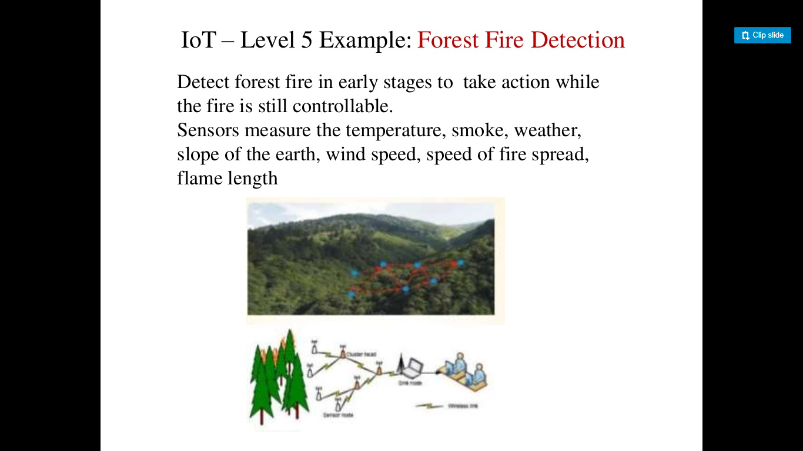

Slide 29
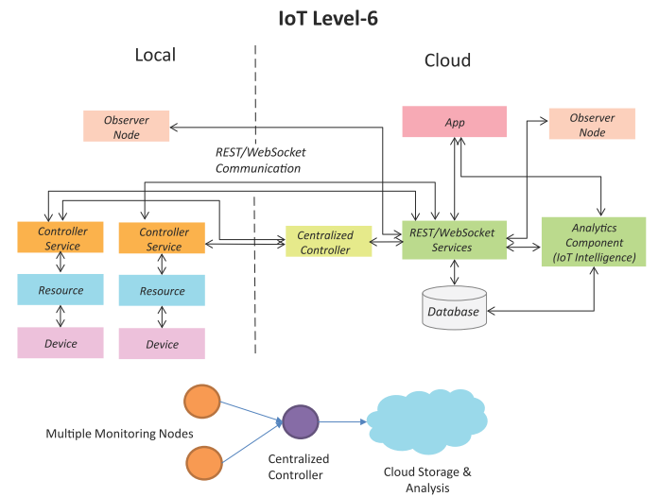
IoT Level-6
A level-6 IoT system has multiple independent end nodes that perform sensing and/or actuation and send data to the cloud.
Data is stored in the cloud and application is cloud-based.
The analytics component analyzes the data and stores the results in the cloud database.
The results are visualized with the cloud-based application.
The centralized controller is aware of the status of all the end nodes and sends control commands to the nodes.
Book website: http://www.internet-of-things-book.com
Bahga & Madisetti, © 2015

Slide 30
